Slide 1


Lesson-12
李老师& 开课吧人工智能学院课程组
2020.03

Slide 2
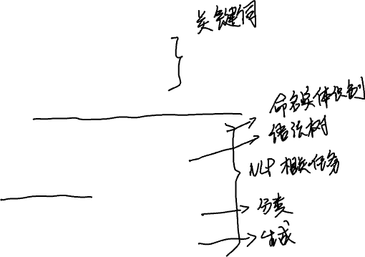
Overview
Key words extraction
TF-IDF
Text-Rank
Machine learning method
Named entity recognition
Dependency parsing
NLP Tasks
Classification tasks
Generation tasks

Slide 3
Key words extraction

Slide 4

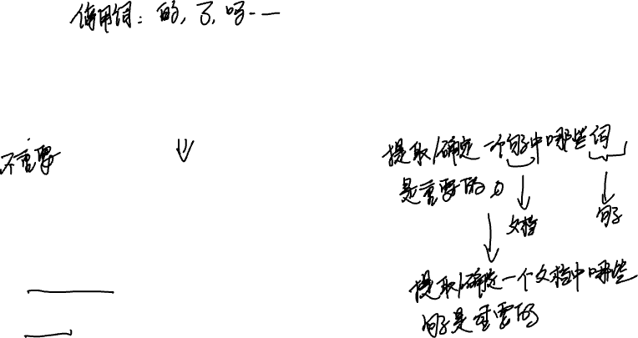
Why key words extraction is important ?
Which words are important in a sentence/document?

Slide 5
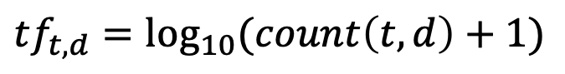
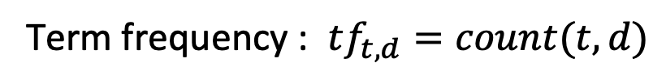
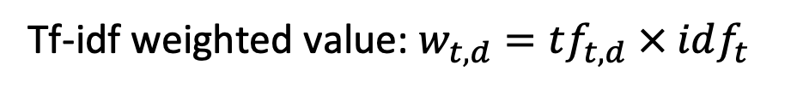
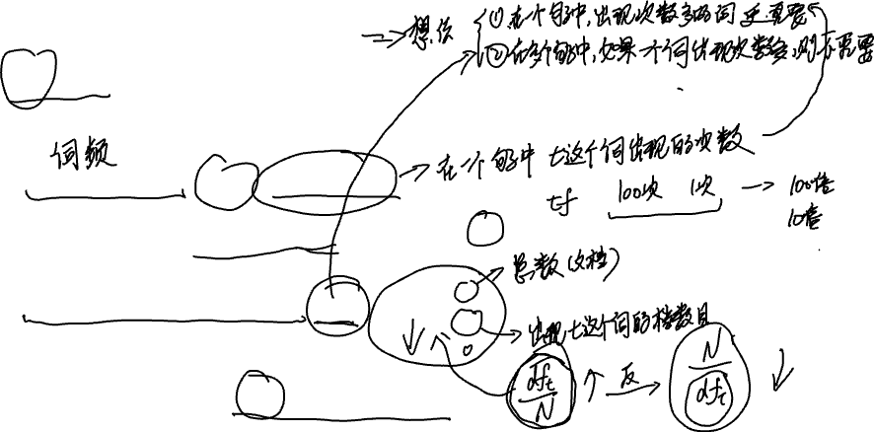
TF-IDF (Term frequency-inverse document)
Term frequency : $tf_{t,d}=count(t,d)$
$$tf_{t,d}=\log_{10}{(count\left(t,d\right)+1)}$$
Inverse document frequency: $idf_{t}=\log_{10}{(\frac{N}{df_{t}})}$
Tf-idf weighted value: $w_{t,d}=tf_{t,d} × idf_{t}$

Slide 6
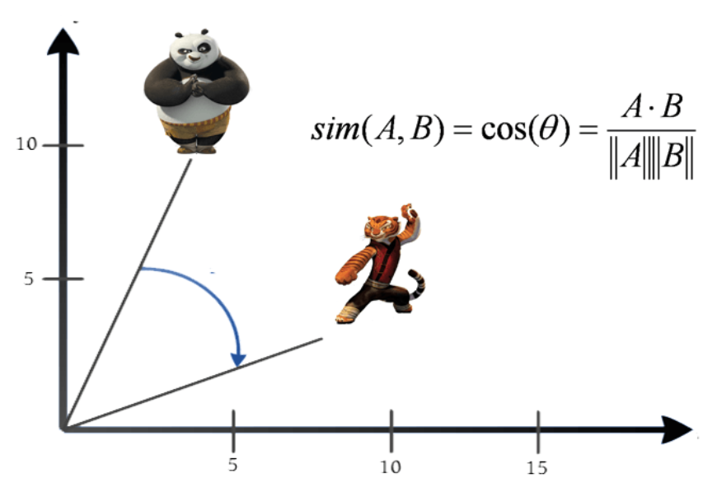
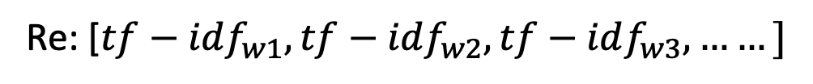
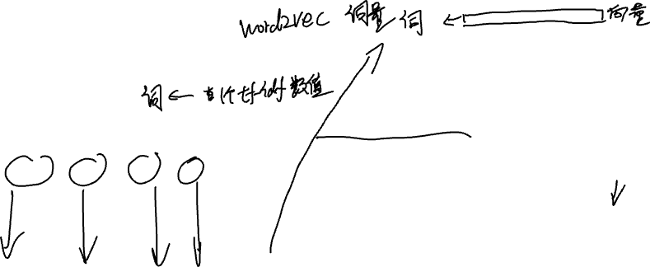
More about tf-idf
Sentence/document representation:
Cosine similarity:
S/D: [word1,word2,word3,word4, ……]
Re: [$tf−idf_{w1},tf−idf_{w2},tf−idf_{w3},……]$

Slide 7
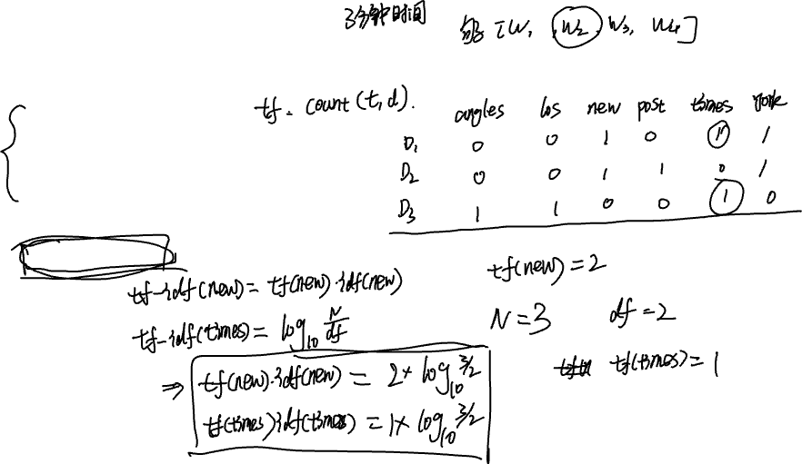
An example of tf-df
D1: “new york times”
D2: “new York post”
D3: “los angeles times”
What is the sentence representation of “new new times” using tf-idf ?

Slide 8
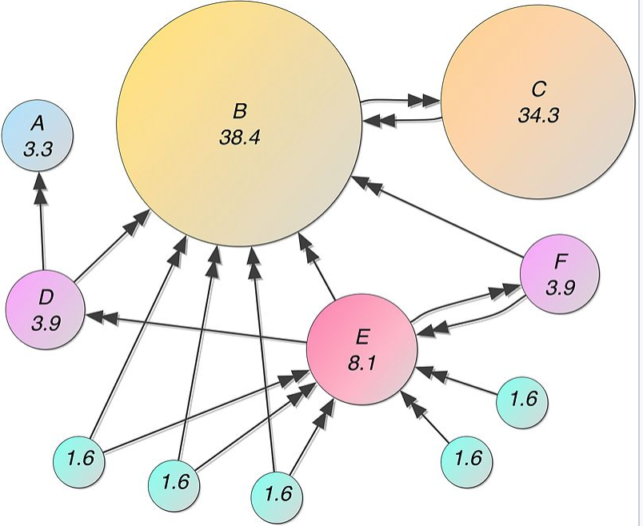
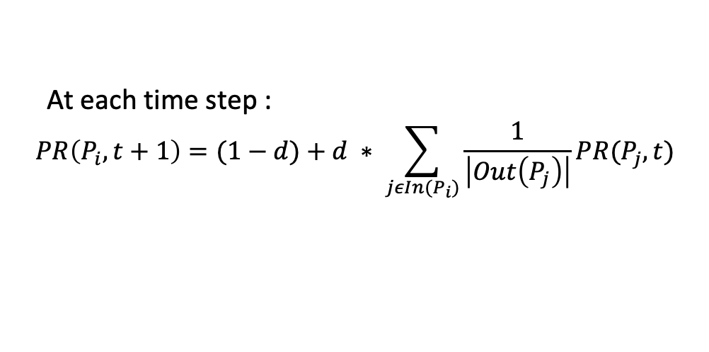
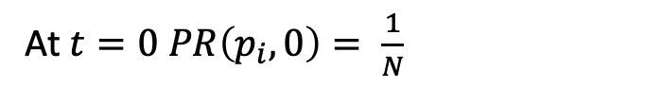
Text-Rank (Graph based extraction)
Page rank:
At $t=0 PR\left(p_{i},0\right)= \frac{1}{N}$
At each time step :
$$PR\left(P_{i},t+1\right)=(1−d)+d ∗ \sum_{jεIn(P_{i})}{\frac{1}{\left|Out\left(P_{j}\right)\right|}PR(P_{j},t)}$$

Slide 9
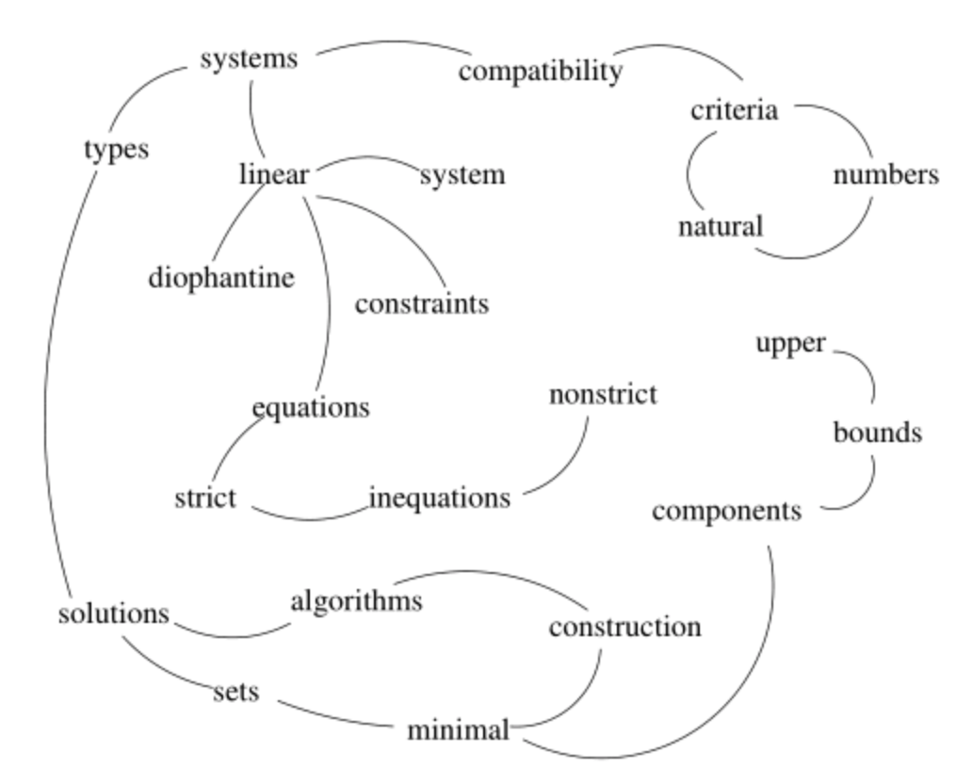
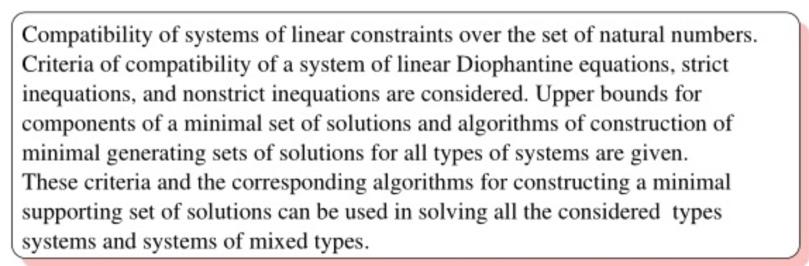
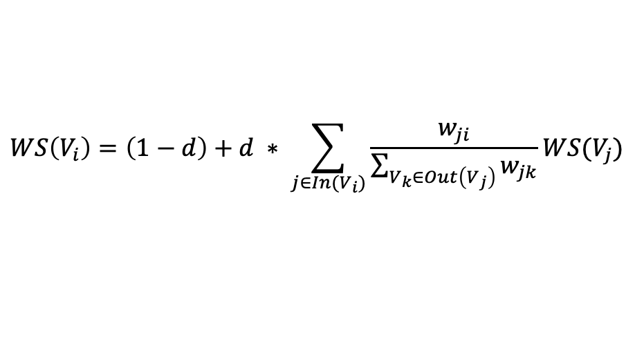
Text-Rank (Graph based extraction)
$$WS\left(V_{i}\right)=\left(1−d\right)+d ∗ \sum_{j∈In(V_{i})}{\frac{w_{ji}}{\sum_{V_{k}∈Out\left(V_{j}\right)}{w_{jk}}}WS(V_{j})}$$

Slide 10
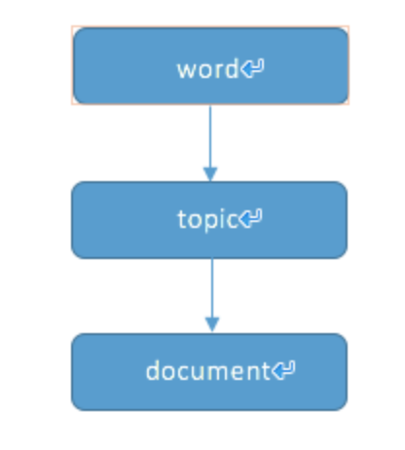
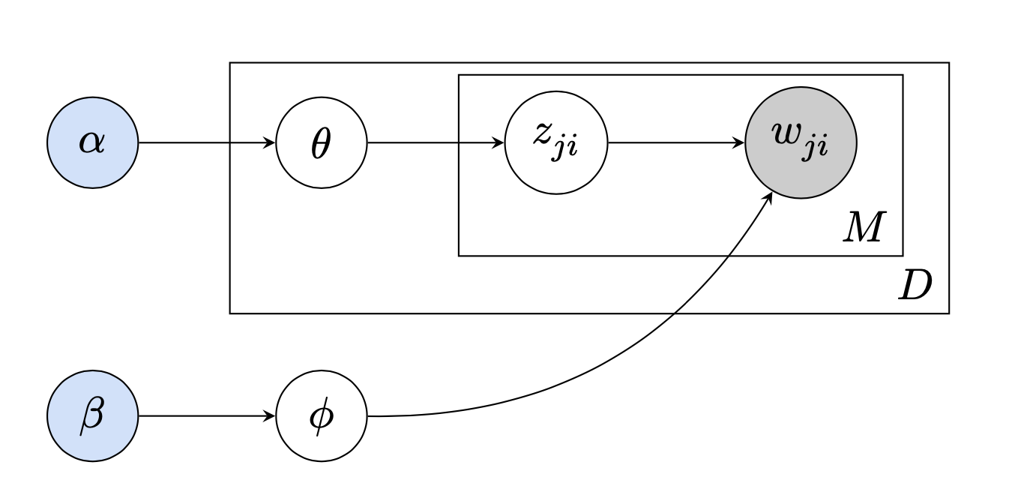
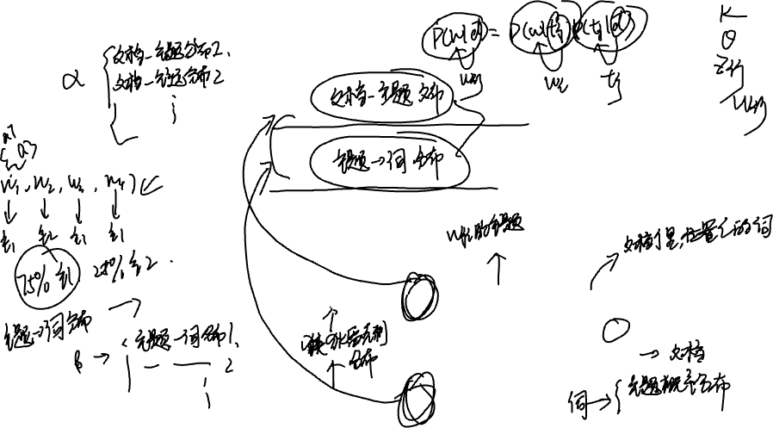
LDA topic model
Assumptions:
Per-document topic distributions: The topics of each document obey a probability distribution.
Per-topic word distributions: The words of each topic obey a probability distribution.

Slide 11
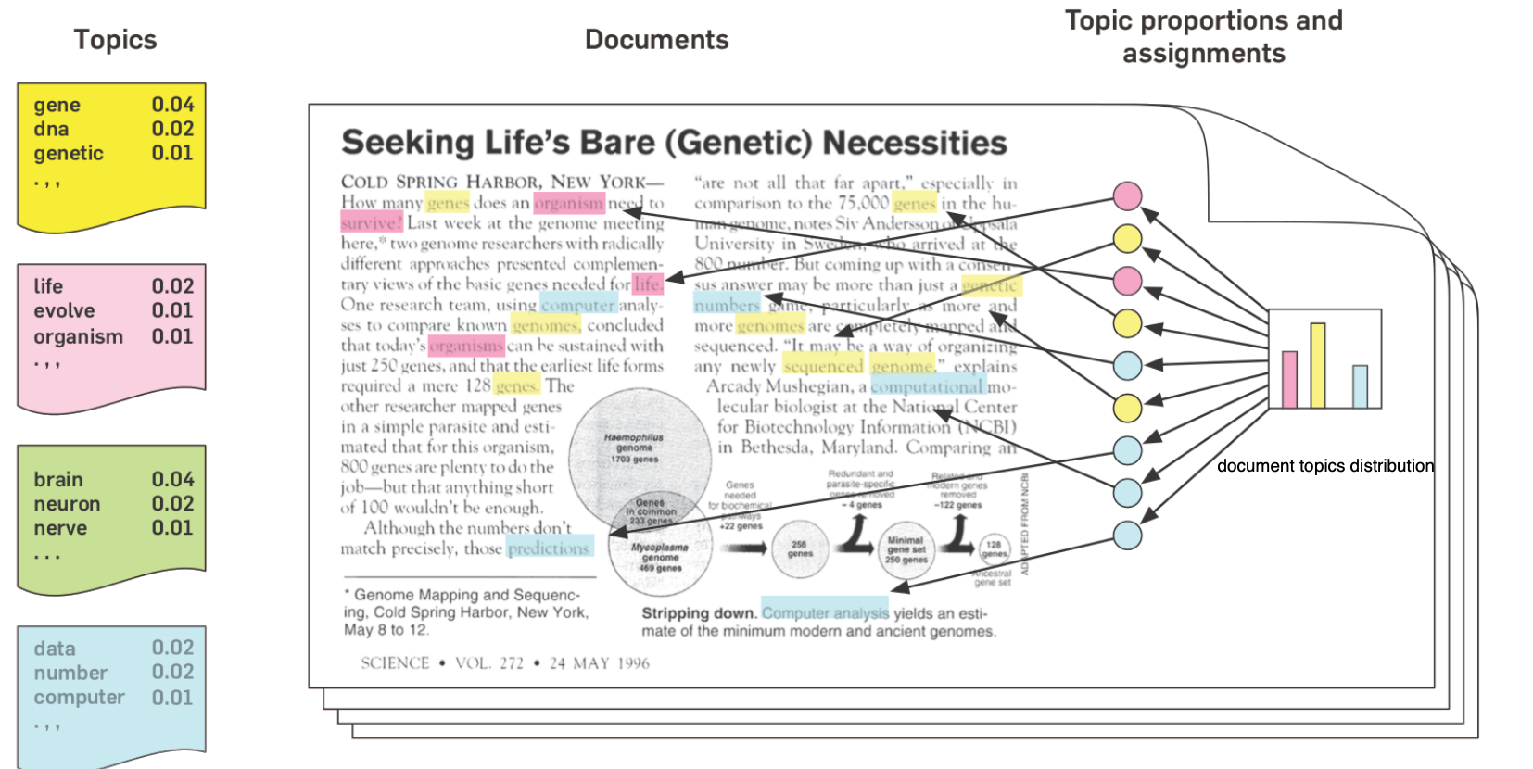
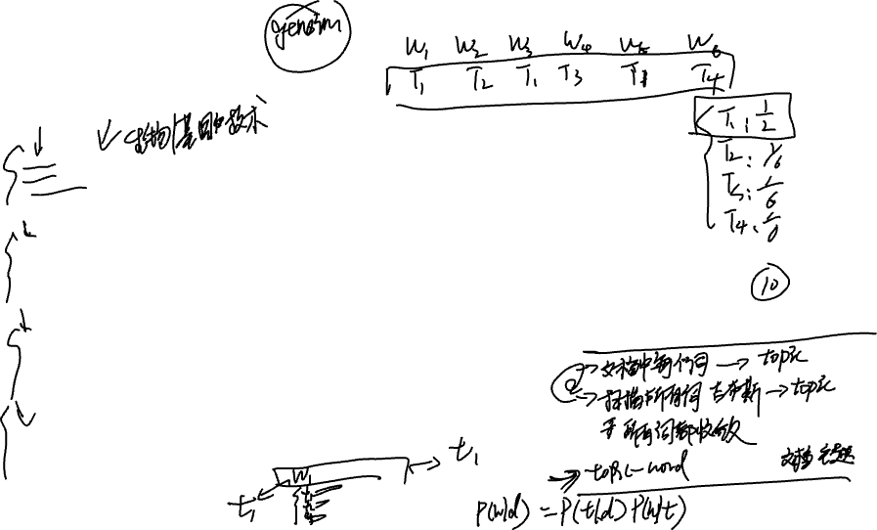
LDA topic model

Slide 12
Word vector
Train a model to learn word vector.
Use k-means algorithm to cluster words.
Compute the distance of each word to the center of the cluster it belongs to.
Pick the nearest K words as key words.

Slide 13
Named entity recognition

Slide 14

What is named entity recognition?
Named entity recognition(NER) = to find each mention of a named entity in the text and label its type.
NER types are application specific:
Commonly include people, places, and organizations
Biomedical domain: names of genes and proteins
Education: codes of college courses

Slide 15
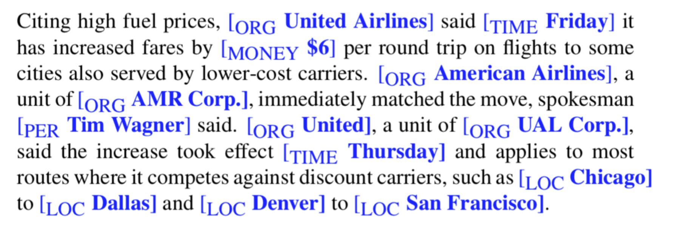

An example

Slide 16
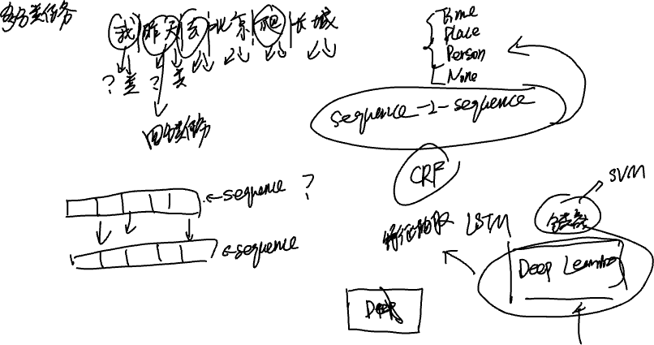
DL based named entity recognition

Slide 17
Dependency parsing

Slide 18
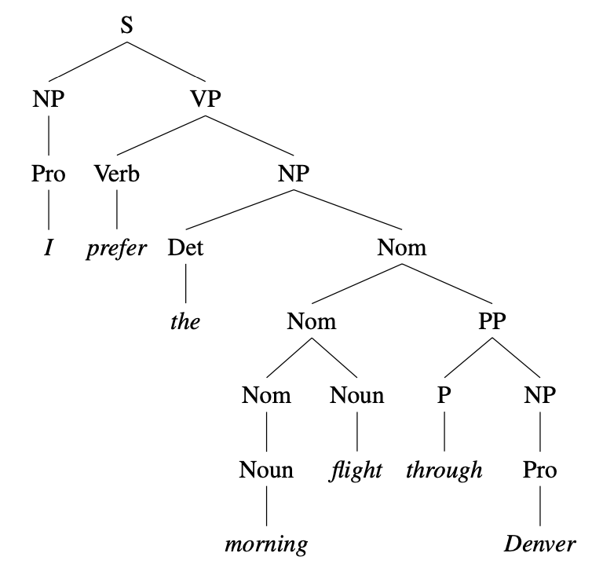
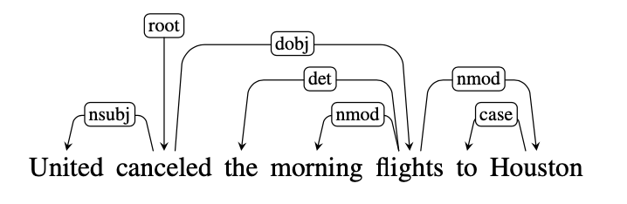
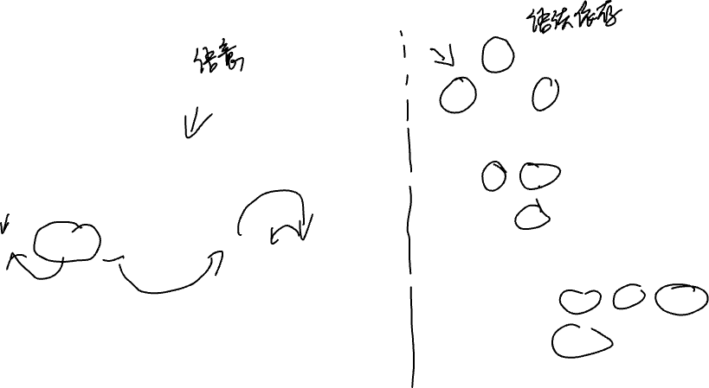
What is dependency parsing ?

Slide 19
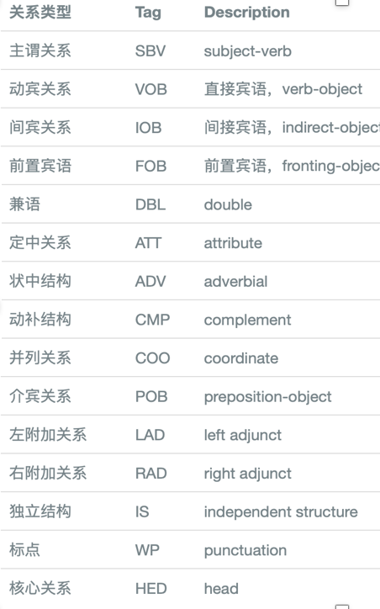
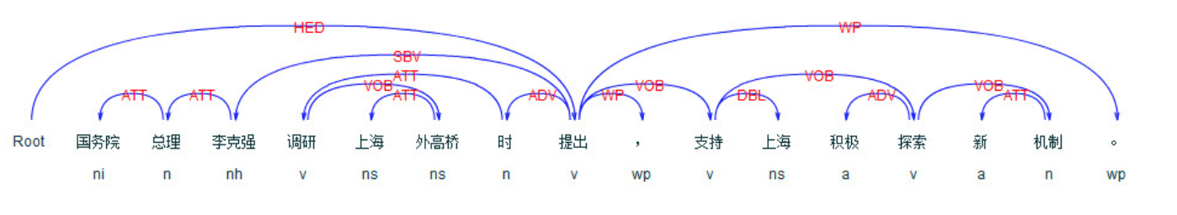
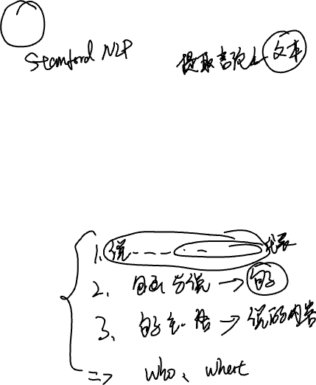
Use ltp to get sentence structure

Slide 20
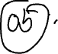
NLP Tasks

Slide 21

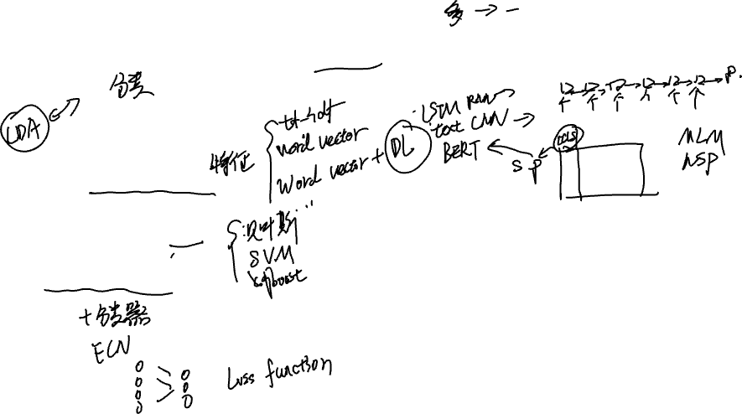
Classification task (text classification)
Text representation
Machine Learning
Deep Learning

Slide 22

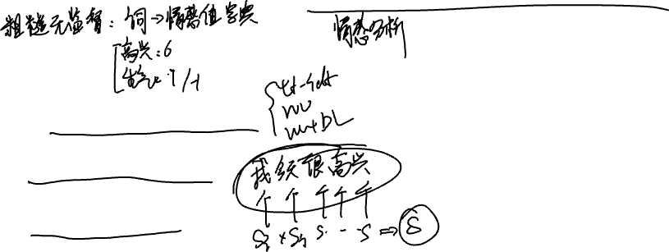
Classification task (sentiment classification)
Sentence representation
Machine Learning
Deep Learning

Slide 23

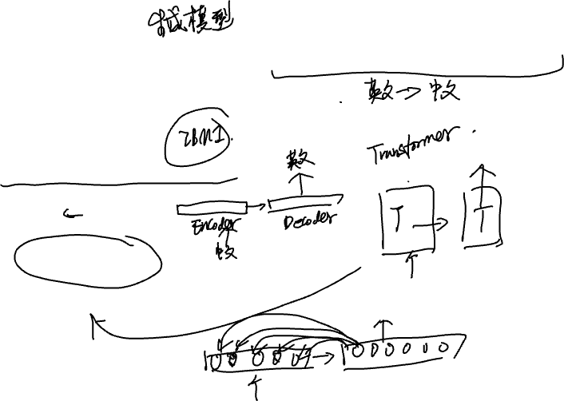

Generation task (Machine translation)
Development path:
→Statistics + EM Algorithm
→RNN
RNN+ Attention
Transformer

Slide 24

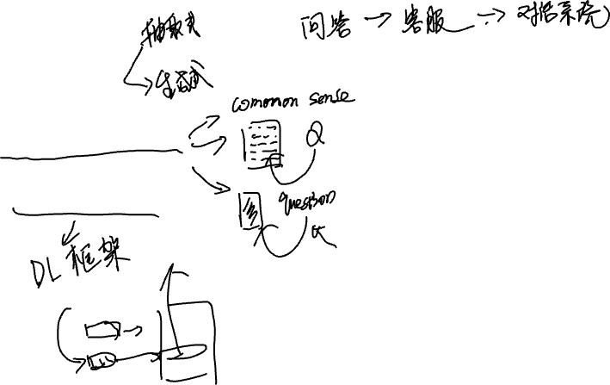
Generation task (Question answering)
Different QA tasks
Deep Learning

Slide 25
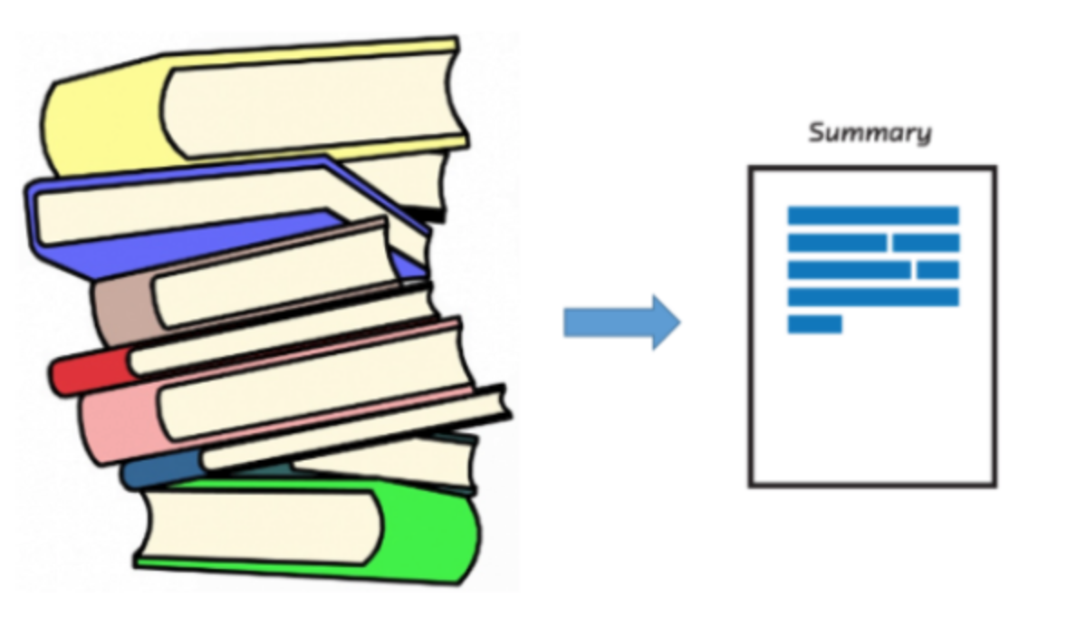
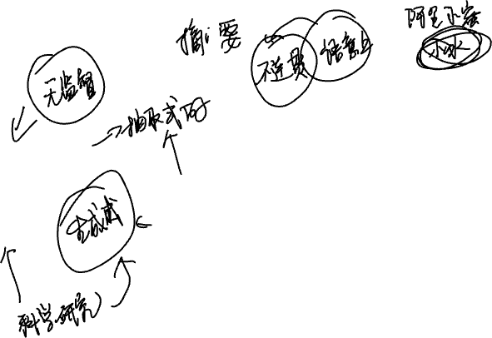
Text summarization
Traditional method
Generation task

Slide 26

Thanks for your attending

